Slide 1
CIS 9660 – Data Mining for Analytics
Week 6 Naïve Bayes (Classification)
Performance Evaluation
Prof. Arturo Castellanos
CIS Department Office: VC11-229

Slide 3
Data Mining Tasks
Prediction Methods
Use some variables to predict unknown or future values of other variables.
Description Methods
Find human-interpretable patterns that describe the data.
From [Fayyad, et.al.] Advances in Knowledge Discovery and Data Mining, 1996

Slide 4
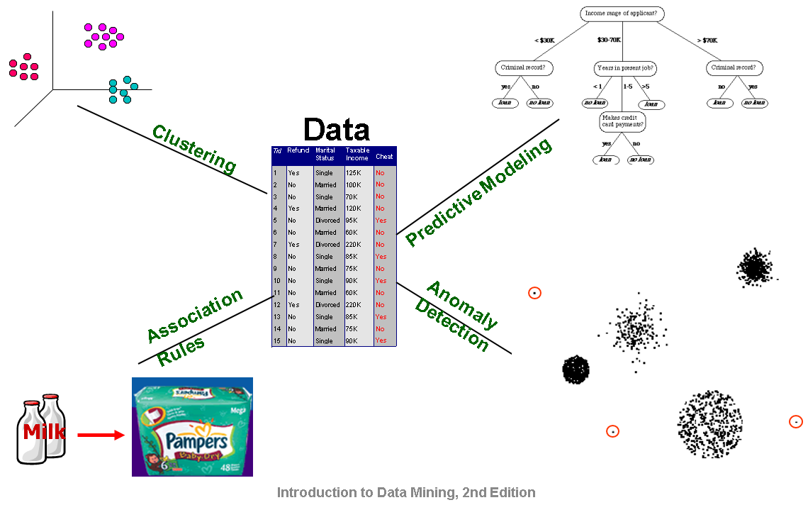

Slide 5
Machine Learning: Supervised vs. Unsupervised Learning
Supervised Learning (Estimation and Classification)
The training data contains target class information for each record (e.g. spam, churn).
New records are classified based on the models developed on the training data (e.g. scoring).
Classification predicts whether something will happen, whereas regression predicts how much something will happen
Unsupervised Learning (Clustering)
The classification of the training data is unknown.
The aim is to construct a set of clusters, given the data.

Slide 6
Types of Variables
Determine the types of pre-processing needed, and algorithms used
Main distinction: Categorical vs. numeric
Numeric
Continuous
Integer
Categorical
Ordered (low, medium, high)
Unordered (male, female)

Slide 7
General Approach for Building Classification Model

Slide 8
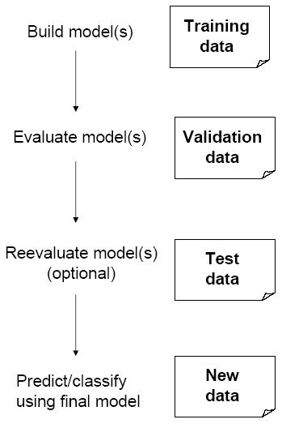
Partitioning the Data
Problem: How well will our model perform with new data?
Solution: Separate data into two parts
Training partition to develop the model
Validation partition to implement the model and evaluate its performance on “new” data
Addresses the issue of overfitting

Slide 9
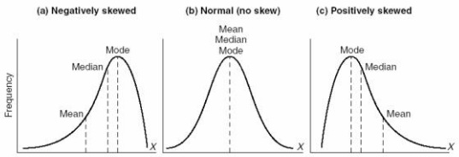
STATS: Skewness
Skewness is a measure of the asymmetry of the probability distribution of a real-valued random variable about its mean. The skewness value can be positive or negative, or even undefined.
Source: Wikipedia
Positive:
Income,
Mileage on used cars for sale,
House prices
Negative:
Scores on an easy test,
scores on a test that a student are motivated,
Age at death in developed countries
Notes:
London 2012 Men's Long Jump qualifying round results

Slide 10
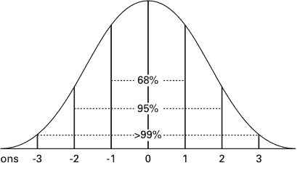
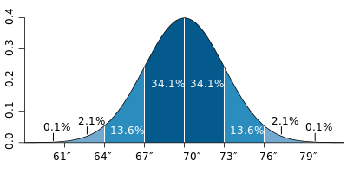
Example:
The average height for adult men in the United States is about 70 inches, with a standard deviation of around 3 inches.
Notes:
As a slightly more complicated real-life example, the average height for adult men in the United States is about 70 inches, with a standard deviation of around 3 inches. This means that most men (about 68%, assuming a normal distribution) have a height within 3 inches of the mean (67–73 inches) – one standard deviation – and almost all men (about 95%) have a height within 6 inches of the mean (64–76 inches) – two standard deviations. If the standard deviation were zero, then all men would be exactly 70 inches tall. If the standard deviation were 20 inches, then men would have much more variable heights, with a typical range of about 50–90 inches. Three standard deviations account for 99.7% of the sample population being studied, assuming the distribution is normal (bell-shaped).

Slide 11
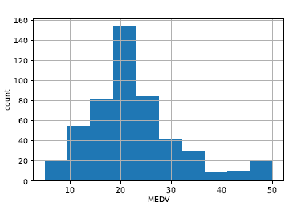
Histograms
Boston Housing example:
Histogram shows the distribution of the outcome variable (median house value)
About 20 neighborhoods had a median house value in the lowest bin, about $4000K to $9500 (these data are from mid-20th century)
## histogram of MEDV
ax = housing_df.MEDV.hist()
ax.set_xlabel('MEDV'); ax.set_ylabel('count')

Slide 12
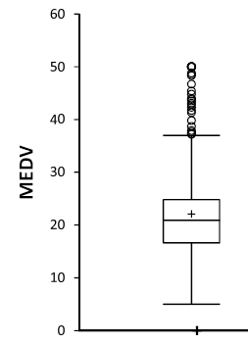
Box Plot
Top outliers defined as those above Q3+1.5(Q3-Q1).
“max” = maximum of non-outliers
Analogous definitions for bottom outliers and for “min”
Details may differ across software
outliers
“max”
Quartile 3
Median
Quartile 1
“min”

Slide 13
CIS 9557 – Business Analytics
Week 5 Multiple Linear Regression
Prof. Arturo Castellanos
CIS Department Office: VC11-B242

Slide 14
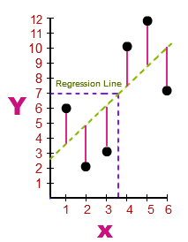
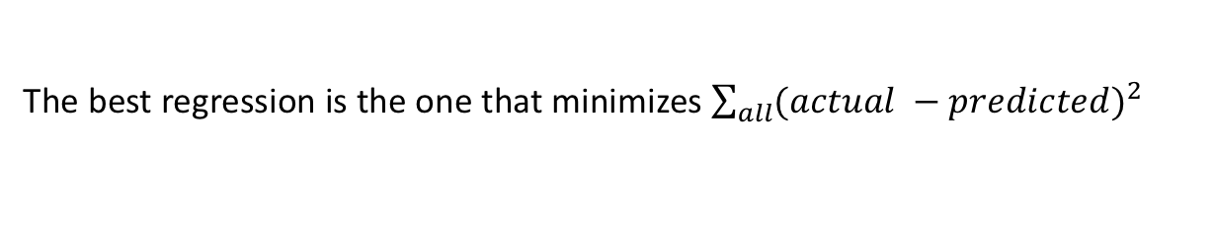
The goal is to minimize the errors from the actual data to the regression line. The least squares line minimizes the sum of the square of the errors.
The actual data points (x,y) in blue.
The Regression Line of the dependent (y) variable based on the independent (x) variable is shown in black.
The errors (residuals) are the vertical distances between the observed values of y and the predictions of the "line of best fit," shown in red.
Source: https://math.tutorvista.com/
The best regression is the one that minimizes $\sum_{all}{{(actual −predicted)}^{2}}$
Training points
Predictions from regression
y = mx + b

Slide 15

One of the drawbacks for using SSE, however, is that it increases as the number of data points increase.
Potential solution: R-squared
R² describes the proportion of variance of the dependent variable explained by the regression model. If the regression model is “perfect”, R² is 1.
How much of the change in the output (y) is explained by the change in my input (x). 0 < R² < 1. Not affected by the number of data points.

Slide 16
CIS 9660 – Data Mining for Analytics
Week 6 Naïve Bayes (Classification)
Performance Evaluation
Prof. Arturo Castellanos
CIS Department Office: VC11-229

Slide 17
Naïve Bayes: The Basic Idea
For a given new record to be classified, find other records like it (i.e., same values for the predictors)
What is the prevalent class among those records?
Assign that class to your new record

Slide 18
Naïve Bayes Calculations
Same goal as before
Compute 2 quantities:
Proportion of “charges = y” among frauds, times proportion of “small” among frauds, times proportion frauds = 3/4 * 1/4 * 4/10 = 0.075
Prop “charges = y” among truthfuls, times prop. “small” among truthfuls, times prop. truthfuls = 1/6 * 4/6 * 6/10 = 0.067
P(fraud | charges, small) = 0.075/(0.075+0.067)
= 0.53

Slide 19
Alternate Accuracy Measures
 |  | Actual Class
 |  | 0 | 1
Predicted Class | 0 | 2689 | 85
 | 1 | 25 | 201 (TPs)
What would be the Precision, Recall, and f-measure for this model?

Slide 20

ROC’s are one way to measure a model’s effectiveness in separating the “wheat from the chaff”
“Lift” (“gains”) is a similar metric, but measuring “how much does the model improve on random chance in finding the class of interest”

Slide 21
Introducing Costs & Benefits
Suppose:
Profit from a “1” is $10
Cost of sending offer is $1
Then:
Under naïve rule, all are classified as “0”, so no offers are sent: no cost, no profit
Under DM predictions, 28 offers are sent.
8 respond with sale of $10 each
20 fail to respond, cost $1 each
972 receive nothing (no cost, no profit)
Net profit = $60

Slide 22
Association Rules
Goal: Create rules of the form: “if this, then that”
Applications:
Product recommendation (Amazon’s “customer’s who bought this also bought X)
Music recommendations (Pandora, Spotify)
Course recommendation (Coursera)
Merchants (Visa)

Slide 23
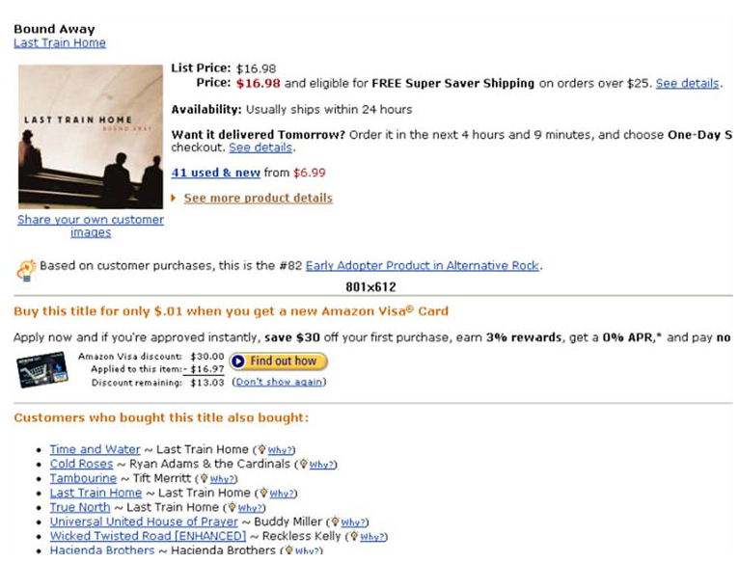
Used in many recommender systems

Slide 24


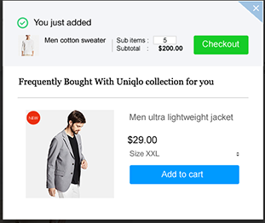
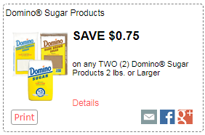
Source: https://charlesngo.com/ecommerce-upselling-cross-selling-shopify/

Slide 25
Terms
“IF” part = antecedent
“THEN” part = consequent
“Item set” = the items (e.g., products) comprising the antecedent or consequent
Antecedent and consequent are disjoint (i.e., have no items in common)

Slide 26
Market Basket Analysis
Retail – different customers, different baskets, different quantities, different times.
MBA uses this information to:
Identify who your customers are
Gain insight about merchandise (products):
Fast and slow moving prpducts
Products which are purchased together
Products which might benefit from promotion
Take action:
Store layouts
Which products to put on specials, promote, coupons…
Combining all of this with a customer loyalty card it becomes even more valuable

Slide 27
Market Basket Analysis
Also known as association rule discovery or affinity analysis.
The data consists of two variables: a transaction and an item.
For each transaction there are a list of items (e.g. a customer buys 5 items at the supermarket).
An association rule is a statement of the form A => B
The strength of the association is measure by the support and confidence of the rule.
Support is symmetric: sup(A=>B) = sup(B=>A)

Slide 28
Analysis of credit card purchases.
Analysis of telephone calling patterns.
Identification of fraudulent medical insurance claims
Analysis of telecom service purchases.
Notes:
Source: http://www.albionresearch.com/data_mining/market_basket.php

Slide 29
Managerial Questions:
How many people bought both Product A and Product B?
People who purchased Product A also generally buy which other products?
Students who enrolled in Course A also frequently enroll in which other courses?

Slide 30
Examples
Rule form: LHS → RHS
IF a customer buys diapers, THEN they also buy beer
diapers → beer
“Transactions that purchase bread and butter also purchase milk”
bread ∧ butter → milk
Customers who purchase maintenance agreements are very likely to purchase large appliances

Slide 31
Definitions
Support of A ⇒ B is the probability that a customer has both A and B.
Confidence of A ⇒ B is the probability that a customer has B given that the customer has A.
Expected Confidence of A ⇒ B is the probability that a customer has B.
Lift of A ⇒ B is a measure of the strength of the association. If Lift=2 for the rule A=>B, then a customer having A is twice as likely to have B than a customer chosen at random. Lift is the confidence divided by the expected confidence.

Slide 32

Formulas
$$Exp. Conf\left(A⇒B\right)=Probability that a customer has B$$
$$lift\left(A⇒B\right)=\frac{Confidence }{Expected confidence}$$
Lift < 1 indicates a negative dependence (substitution effect)
Lift > 1 indicates a positive dependence (complementary effect)

Slide 33
Market Basket Analysis
A
B
C
A
C
D
B
C
D
A
D
E
B
C
E
Rule
A ⇒ D
C ⇒ A
A ⇒ C
B & C ⇒ D
Support
2/5
2/5
2/5
1/5
Confidence
2/3
2/4
2/3
1/3
...

Slide 34
Market Basket Analysis
A
B
C
A
C
D
B
C
D
A
D
E
B
C
E
Rule
A ⇒ D
C ⇒ A
A ⇒ C
B & C ⇒ D
Support
2/5
2/5
2/5
1/5
Confidence
2/3
2/4
2/3
1/3
...

Slide 35
Preliminary Exploration in Python loading data, viewing it, summary statistics
1. Open Anaconda-Navigator and launch a ‘jupyter’ notebook. It opens a new browser window.
2. Navigate to the directory where your csv file is saved and open a new Python notebook.
import pandas as pd
# Load data
housing_df = pd.read_csv('WestRoxbury.csv')
housing_df.shape #find dimension of data frame
housing_df.head() #show the 1st five rows
print(housing_df) #show all the data

Slide 36
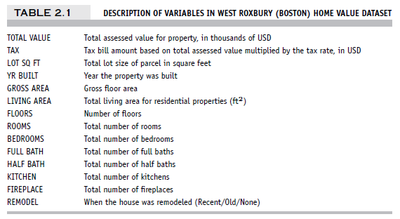
Example – Linear Regression West Roxbury Housing Data

Slide 37
Import Needed Functionality
import numpy as np
import pandas as pd # repeating - we did this
earlier
from sklearn.model_selection import train_test_split
from sklearn.metrics import r2_score
from sklearn.linear_model import
LinearRegression
The abbreviations pd, np, and sm are commonly used in the data science community.

Slide 38
Preliminary Exploration in Python loading data, viewing it, summary statistics
1. Open Anaconda-Navigator and launch a ‘jupyter’ notebook. It opens a new browser window.
2. Navigate to the directory where your csv file is saved and open a new Python notebook.
import pandas as pd
# Load data
housing_df = pd.read_csv('WestRoxbury.csv')
housing_df.shape #find dimension of data frame
housing_df.head() #show the 1st five rows
print(housing_df) #show all the data

Slide 39
Data Prep
# data loading and preprocessing
housing_df = pd.read_csv('WestRoxbury.csv')
housing_df.columns = [s.strip().replace(' ', '_')
for s in housing_df.columns]
housing_df = pd.get_dummies(housing_df,
prefix_sep='_', drop_first=True)
# create list of predictors and outcome
excludeColumns = ('TOTAL_VALUE', 'TAX')
predictors = [s for s in housing_df.columns if s
not in excludeColumns]
outcome = 'TOTAL_VALUE'

Slide 40
Data Exploration in Python, cont.
# Different ways of showing the first 10
# values in column TOTAL_VALUE
housing_df['TOTAL_VALUE'].iloc[0:10]
housing_df.iloc[0:10]['TOTAL_VALUE']
housing_df.iloc[0:10].TOTAL_VALUE # use dot
notation if the column name has no spaces
# Show the fifth row of the first 10 columns
housing_df.iloc[4][0:10]
housing_df.iloc[4, 0:10]
housing_df.iloc[4:5, 0:10] # use a slice to
return a data frame

Slide 41
Data Exploration in Python, cont.
# Use pd.concat to combine non-consecutive
# columns into a new data frame. Axis
# argument specifies dimension along which
# concatenation happens, 0=rows, 1=columns.
pd.concat([housing_df.iloc[4:6,0:2], housing_df.iloc[4:6,4:6]], axis=1)
# To specify a full column, use:
housing.iloc[:,0:1]
housing.TOTAL_VALUE
housing_df['TOTAL_VALUE'][0:10] # show the
first 10 rows of the first column

Slide 42
Data Exploration in Python, cont.
# Descriptive statistics
print('Number of rows ', len(housing_df['TOTAL_VALUE'])) # show length
of first column
print('Mean of TOTAL_VALUE ', housing_df['TOTAL_VALUE'].mean()) # show mean
of column
housing_df.describe() # show summary
statistics for each column

Slide 43
Replacing Missing Data with Median
# To illustrate missing data procedures, we first convert a few entries for bedrooms to NA's. Then we impute these missing values using the median of the remaining values.
missingRows = housing_df.sample(10).index
housing_df.loc[missingRows, 'BEDROOMS'] = np.nan
print('Number of rows with valid BEDROOMS values
after setting to NAN: ',
housing_df['BEDROOMS'].count())
# remove rows with missing values
reduced_df = housing_df.dropna()
print('Number of rows after removing rows with missing values: ', len(reduced_df))

Slide 44
Partitioning the Data
# set random_state for reproducibility
# training (60%) and validation (40%)
trainData, validData = train_test_split(housing_df,
test_size=0.40, random_state=1)
# produces Training: 3481 Validation: 2321
# training (50%), validation (30%), and test (20%)
trainData, temp = train_test_split(housing_df, test_size=0.5, random_state=1)
# now split temp into validation and test
validData, testData = train_test_split(temp, test_size=0.4, random_state=1)
# produces Training: 2901 Validation: 1741
Test: 1160

Slide 45
Fit Model and Make Predictions (Training Data)
model = LinearRegression()
model.fit(train_X, train_y)
train_pred = model.predict(train_X)
train_results = pd.DataFrame({
'TOTAL_VALUE': train_y,
'predicted': train_pred,
'residual': train_y - train_pred
})
# show sample of predictions
train_results.head()

Slide 46
Scoring the validation data
valid_pred = model.predict(valid_X)
valid_results = pd.DataFrame({
'TOTAL_VALUE': valid_y,
'predicted': valid_pred,
'residual': valid_y - valid_pred
})
valid_results.head()
TOTAL_VALUE predicted residual
1822 462.0 406.946377 55.053623
1998 370.4 362.888928 7.511072
5126 407.4 390.287208 17.112792
808 316.1 382.470203 -66.370203
4034 393.2 434.334998 -41.134998

Slide 47
Creating binary dummies
# use drop_first=True to drop the first dummy
variable
housing_df = pd.get_dummies(housing_df,
prefix_sep='_', drop_first=True)
housing_df.columns
housing_df.loc[:,'REMODEL_Old':
'REMODEL_Recent'].head(5)
output on next slide…

Slide 48
Alternative Codes for Scatterplot
Using pandas:
## scatter plot with axes names
housing_df.plot.scatter(x='LSTAT', y='MEDV', legend=False)
Using matplotlib:
## Set the color of points and draw as open circles.
plt.scatter(housing_df.LSTAT, housing_df.MEDV, color='C2', facecolor='none')
plt.xlabel('LSTAT'); plt.ylabel('MEDV')

Slide 49
Fitting a Regression Model to the Toyota Data
# reduce data frame to the top 1000 rows and select columns for
regression analysis
car_df = pd.read_csv('ToyotaCorolla.csv')
car_df = car_df.iloc[0:1000]
predictors = ['Age_08_04', 'KM', 'Fuel_Type', 'HP', 'Met_Color',
'Automatic', 'CC', 'Doors', 'Quarterly_Tax', 'Weight'] outcome = 'Price'
# partition data
X = pd.get_dummies(car_df[predictors], drop_first=True)
y = car_df[outcome]
train_X, valid_X, train_y, valid_y = train_test_split(X, y, test_size=0.4,
random_state=1)
car_lm = LinearRegression()
car_lm.fit(train_X, train_y)
put 40% in validation (test) partition

Slide 50
Output of the Regression Model
# print coefficients
print(pd.DataFrame({'Predictor': X.columns, 'coefficient':
car_lm.coef_}))
Partial Output
Predictor coefficient
0 Age_08_04 -140.748761
1 KM - 0.017840
2 HP 36.103419
3 Met_Color 84.281830
4 Automatic 416.781954
5 CC 0.017737
6 Doors -50.657863
7 Quarterly_Tax 13.625325
8 Weight 13.038711
9 Fuel_Type_Diesel 1066.464681
10 Fuel_Type_Petrol 2310.249543

